Slide 1
CSE 323 Computer Architecture
Lecture 7: Input /Output
Anisur Rahman
Military Institute of Science and Technology

Slide 2
Outline
General
Interfacing I/O Devices to CPU
Processor involved I/O : Between Memory and External Devices
DMA
I/O Channel
Infini Band

Slide 3
External Devices : Types
Human readable
Screen, printer, keyboard
Machine readable
HDD
Communication
Modem
Network Interface Card (NIC)

Slide 4
Classification : I/O Devices
Block devices
Information is stored in fixed size blocks
Block sizes range from 128-1024 bytes
I/O is done by reading/writing blocks
Hard disks, floppies, CD ROMS, tapes are in this category
Character devices
I/O is done as characters (ie., stream of bits)
Terminals, printers, mouse, joysticks are in this category

Slide 5
IO Interface
I/O devices can not directly communicate with the CPU due to various differences between them.
Major issues :-
Wide variety of peripherals
Different data formats
Different control logics
Differs in speed with CPU / RAM
Un-necessary to build all the different control logics into a Processor, thus complicating it.
Therefore there is a need for I/O modules
IO interface provides a method for transferring information between Processor , Memory and external I/O devices.

Slide 6
I/O Module Function
Provide interfaces for communication between the CPU / Memory and I/O devices:-
Internal : Processor and Memory
External : I/O devices
Control & Timing
Generate address for each I/O device.
Synchronize timing for I/O op.
Contains logic specific to each device it controls.
Data Buffering
Error Detection
Hide details of timing, formats, and the electromechanics of external device allowing processor to function in terms of simple R/W commands.

Slide 7
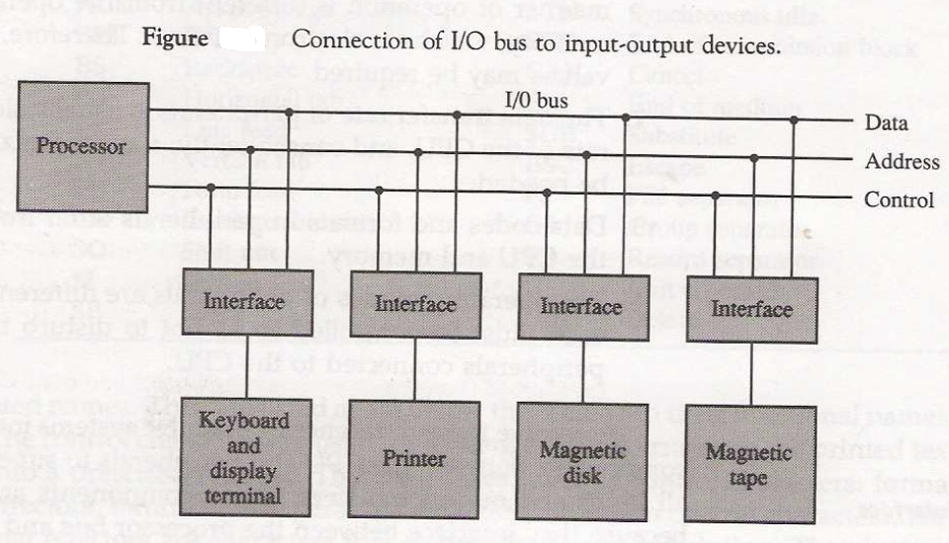
I/O Bus and Interface Modules

Slide 8
I / O Module : Functioning
I/O bus is attached to all peripherals through their respective I/O interfaces.
The Interfaces monitor address on address lines.
CPU puts address of I/O device on address lines
On finding its own address, the respective I/O interface, activates path between itself and the I/O device.
All the other devices are disabled by their interfaces.
CPU initiates communication :
I/O command is made available in the control lines.
I/O module responds to CPU communication :
Data to read or write is made available in the data lines.

Slide 9
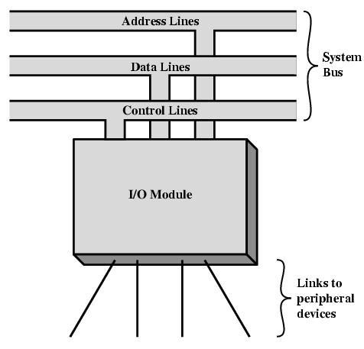
Generic I/O Module

Slide 10
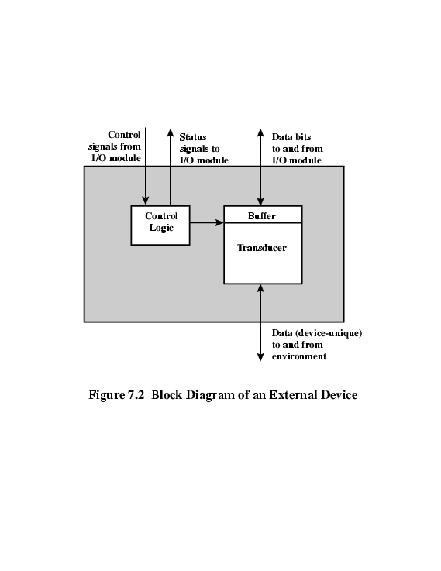
External Device Block Diagram(NC)
Converts energy one from to another

Slide 11
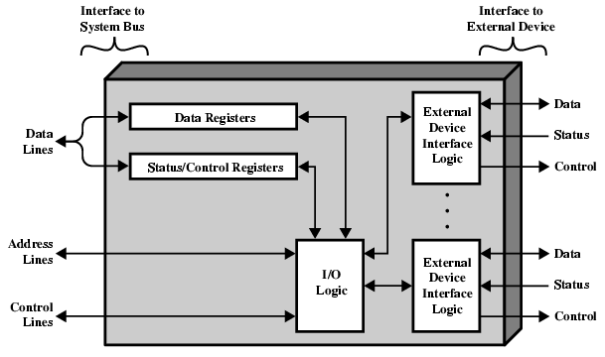
I/O Module: Internal Block Diagram

Slide 12
Interfacing I/O Devices to CPU

Slide 13
Interfacing I/O Devices
I/O devices can be connected to microprocessor in two modes :-
Parallel. Done in groups of 8 bits using the entire data bus.
Serial. Data is transferred one bit at a time using the SID and SOD pins on the Microprocessor.

Slide 14
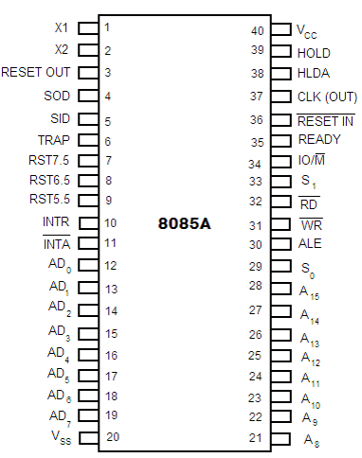
Serial : I/O
The SID and SOD pins (5 & 4) are used to connect serial devices to the processor directly.
The serial devices are connected using a I/O module which will function as discussed earlier to control the communication between processor and I/O device.
Multiple serial devices can be connected to these two pins , using multiplexing techniques.

Slide 15
Parallel I/O(Discussed)
There are 3 ways in which Processor communicates with memory and IO :-
Separate buses for memory and I/O devices
Shared data and address bus :-
Isolated I/O – separate control lines.
Memory Mapped I/O – common control lines.

Slide 16
Isolated IO
In the first method, CPU has independent set of buses for both memory and IO. It is done in computers that has separate IOP and CPU.
In second method (Isolated I/O) :-
Common bus used to transfer data between IO / memory and CPU. However, a separate control line (IO/M pin) is used.
IO is activated using a high state during IO transfer & memory is activated using low state during memory transfer.
This configuration isolates all I/O interface address with the memory address and is referred to as Isolated IO method.

Slide 17
IO/M Pin : Select Memory / IO device
This status signal indicates that the read / write operation relates to whether the memory or I/O device.
High to indicate an I/O operation.
Low for memory operations.

Slide 18
Isolated IO
I/O devices are treated separately from memory.
I/O devices are assigned an address / “port number” within the 8-bit address range of 00H to FFH.
The user in this case would access these devices using the IN and OUT instructions only.

Slide 19
Memory Mapped IO
In third method (Memory Mapped I/O) :-
Computer treats interface as part of the memory system.
Same address space is used for both memory and IO interface.
Address space assigned to I/O interface cannot be used for memory.
The user uses the same instructions used for memory read / write

Slide 20
Difference :Memory & I/O mapped
Memory Mapped | I/O Mapped
IO is treated as memory. | IO is treated as external device.
Memory & I/O share the entire address range of processor | Processor provides separate address range for memory & I/O
Processor provides more address lines for accessing memory | Less address lines for accessing I/O
More Decoding is required | Less decoding is required
Memory control signals used to control Read & Write I/O operations | I/O control signals are used to control Read & Write I/O operations
16-bit addressing. | 8-bit addressing.
Memory Instructions are used. | Special Instructions are used like IN, OUT.
Arithmetic and logic operations can be performed on data. | Arithmetic and logic operations can not be performed on data.

Slide 21
Processor involved I/O : Between Memory and External Devices

Slide 22
Input Output : Types
I/O to Memory transfer through CPU :-
Programmed I/O
Interrupt driven I/O
Direct I/O device to Memory channel :
Direct Memory Access (DMA)

Slide 23
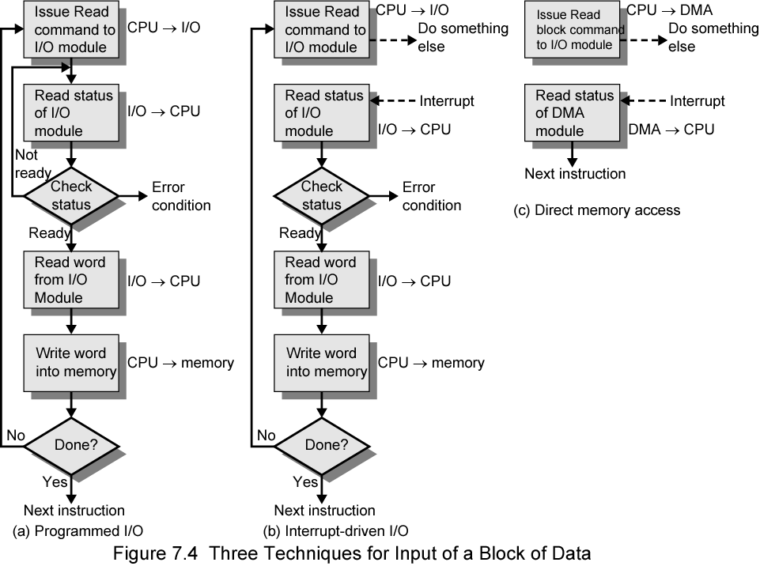
Input Output : Types(Flow Chart)

Slide 24
Programmed I/O : Basics(Discussed)->copy
CPU requests I/O operation on behalf of a process
Process waits for the I/O operation to complete
CPU has direct control over I/O
Sensing status periodically
Issues read/write commands to transfer data
CPU completes data transfer and the process starts execution.
Wastes CPU time
PROGRAMMED I/O MODE NOT APPROPRIATE DUE TO PROLONGED WAIT STATES IN CASE OF ASYNCHRONOUS I/O DEVICES LIKE KEYBD

Slide 25
Interrupt Driven I/O : Basics
The processor receives an I/O command from an I/O device
The process under execution is suspended and the I/O is initiated by processor
The processor may execute another process during I/O progress
When the I/O device is ready, the processor is interrupted to notify same, and I/O begins
Advantages:-
I/O module interrupts when ready
Overcomes CPU waiting
No repeated CPU checking of device

Slide 26
Interrupts
Interrupt is a mechanism through which an external device can get the attention of the microprocessor
The process starts from the I/O device
The process is asynchronous.
An interrupt is considered to be an emergency signal that may be serviced.
When the Microprocessor receives an interrupt signal, it suspends the currently executing program and jumps to an Interrupt Service Routine (ISR) to respond to the incoming interrupt.
Each interrupt generally has its own ISR.

Slide 27
Classification of Interrupts
Interrupts can be classified into two types:
Maskable Interrupts
Can be delayed or Rejected
Enabled Or Disabled By EI And DI Instruction
Non-Maskable Interrupts
Can not be delayed or Rejected
Interrupts can also be classified into:
Vectored - address of the service routine is hard-wired
Non-vectored - address of the service routine needs to be supplied externally by the device

Slide 28
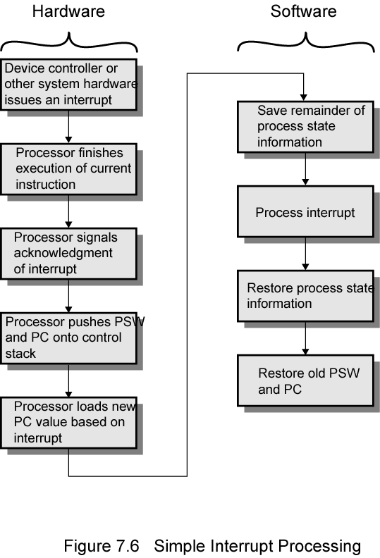
Interrupt Driven I/O : Basic Operation

Slide 29
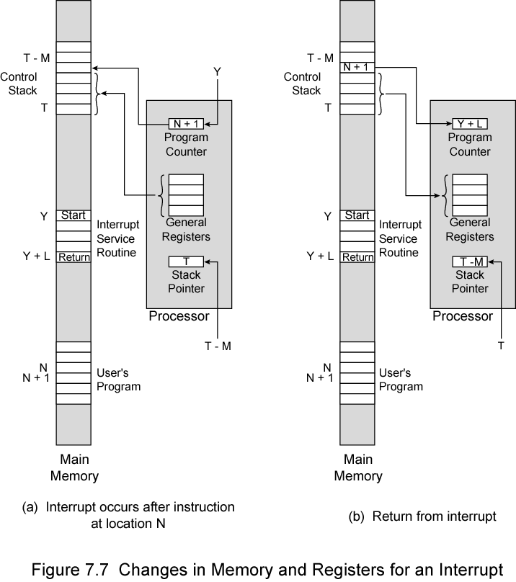
Memory and Registers States : Interrupt

Slide 30
Design Issues
How do you identify the module issuing the interrupt?
How do you deal with multiple simultaneous interrupts?

Slide 31
Identifying Interrupting Module
Different line for each module ?
Impractical to have large number of interrupt lines / pins on a processor
How can one decide on the number of devices
Software poll
INTR and INTA lines are used
CPU branches execution to a generic Interrupt Service Routine (ISR)
ISR checks which each I/O module in turn to identify the interrupting device
On identifying I/O device suitable device service routine executed
Slow

Slide 32
Identifying Interrupting Module
Hardware poll / Daisy Chain
I/O Modules are daisy chained
Interrupt Acknowledge sent down a chain
Module responsible places vector / address of it’s service routine on bus
CPU executes the Device service Routine
Bus Arbitration / Master
Module must claim the bus before it can raise interrupt
The vector address of the Device Service Routine is then placed on data bus

Slide 33
Resolving Multiple Interrupts
There are number of IO devices attached to the computer.
They are all capable of generating the interrupt.
When the interrupt is generated from more than one device, priority interrupt system is used to determine which device is to be serviced first.
Devices with high speed transfer are given higher priority and slow devices are given lower priority.

Slide 34
Resolving Multiple Interrupts
Assign each device a priority level for purpose of interrupts
Software polled devices are polled in the order of their priority
Hardware polled devices :-
Daisy chained according to priority
Hardware priority controller unit used
In bus mastering only current master can interrupt

Slide 35
Software Polling : Procedure
There is one common Interrupt Sub Routine for all I/O devices.
The common ISR identifies as well as resolves priority in case of multiple interrupts.
This ISR contain code to poll the interrupt sources in sequence as per pre-defined priority.
The particular device service routine of the interrupting device is then executed.
Disadvantage. Polling time can be long if large number of I/O devices are connected.

Slide 36
Hardware Polling : Procedure
Hardware priority unit functions as an overall manager.
It identifies interrupt requests and determine the priorities.
Serial / Daisy chaining. Polling is required
Parallel Priority system. Polling is not required

Slide 37
Serial or Daisy Chaining Priority
Devices are connected in order of priority.
Device that wants the attention send the interrupt request to the CPU.
CPU sends INT ACK signal which is applied to PI(priority in) of the first device.
If it had requested the attention, it place its VAD(vector address) on the bus. And, it blocks the signal by placing 0 in PO(priority out).
If not, it passes the signal to next device through PO(priority out) by placing 1.
This process is continued until appropriate device is found.
The device whose PI is 1 and PO is 0 is the device that sent the interrupt request.

Slide 38
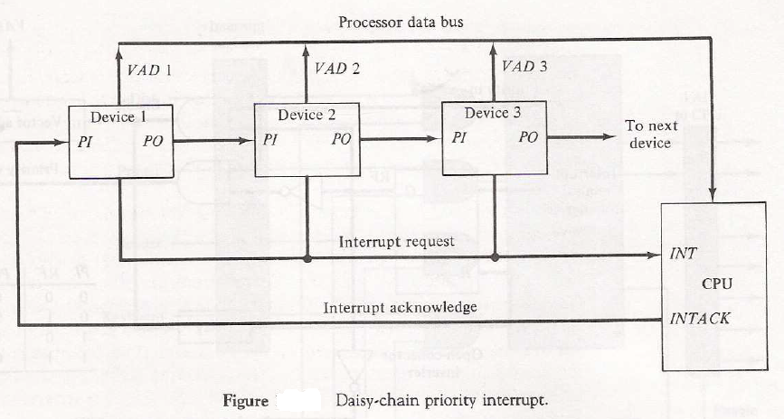
Serial or Daisy Chaining Priority Discussed

Slide 39
Parallel Priority Interrupt Discussed
It consists of interrupt register whose bits are set according to priority of the interrupting devices
Mask register is used to provide masking of lower priority devices by higher priority ones
Corresponding interrupt bit and mask bit are ANDed and applied to priority encoder
Priority encoder
Generates vector address
Generates the INTR signal for CPU

Slide 40
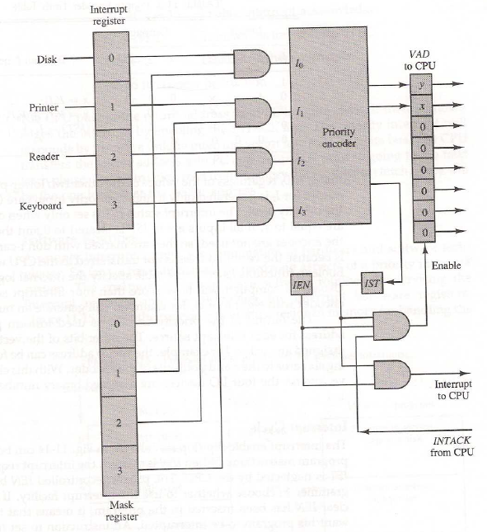
Parallel Priority Interrupt Discussed
Notes:
IEN - interrupt enable flip-flop
IST - interrupt status flip-flop
https://upscfever.com/upsc-fever/en/gatecse/en-gatecse-chp165.html

Slide 41
DMA

Slide 42
Direct Memory Access
Interrupt driven and programmed I/O require active CPU intervention
Transfer rate is limited
CPU is tied up
DMA provides better solution :-
Additional Module (hardware) on bus
DMA controller takes over from CPU for I/O
DMA controller uses buses and transfer the data directly between I/O devices and memory
DMA is a means of having a peripheral device control a processor's memory bus directly.

Slide 43
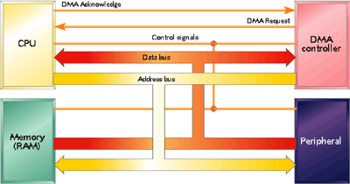
DMA : Configuration

Slide 44
DMA Operation
CPU receives and acks the DMA signal
CPU disconnects itself from the buses
CPU carries on with other work
DMA controller deals with transfer
DMA controller has:-
Device address
Starting address of memory block for data
Amount of data to be transferred
Read/Write
DMA controller interrupts CPU when finished
DMA permits peripheral (UART) to transfer data directly to or from memory without having each byte (or word) handled by the processor.

Slide 45
DMA Controller
Has four registers:-
Address register
Contains address of memory location to read or write
Incremented after each word is transferred
Data register
Contains data
Word count register
Holds the number of words to be transferred.
Decremented by one after each word is transferred into memory and checked for zero
Control register
Each DMA Controller has four request, ack lines and an independent set of a/m registers for each set of req / ack lines
DMA channel - Each set of req / ack line connects an individual I/O device

Slide 46
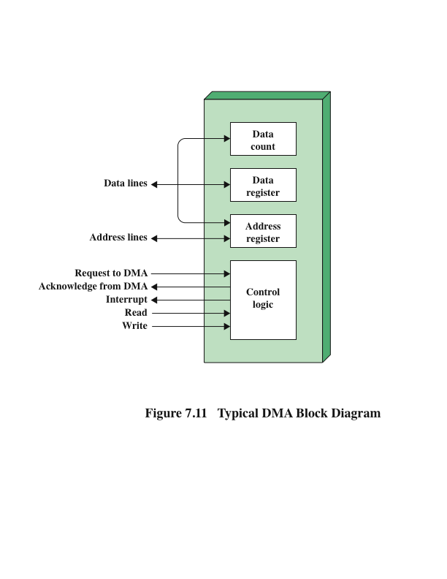
DMA Controller Discussed

Slide 47
DMA : Transfer Modes Discussed
Transfer can be perform in two ways:
Burst Transfer
Number of memory words are transferred in a continuous burst
Done while communicating with fast devices
Cycle Stealing
One data word is transfer at a time
CPU delays it operation for one cycle during which DMA transfer takes place
Slows down CPU. But, not as much as in case of processor involved I/O.

Slide 48
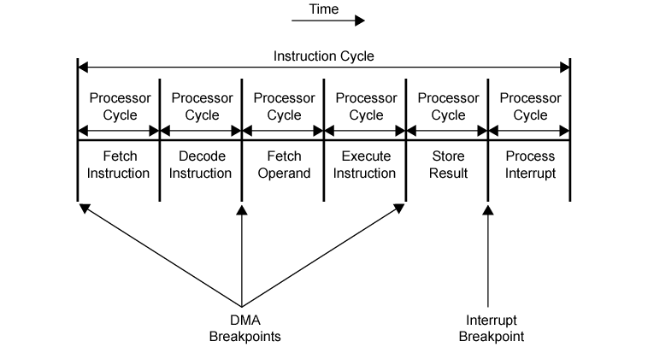
DMA and Interrupt Breakpoints During an Instruction Cycle

Slide 49
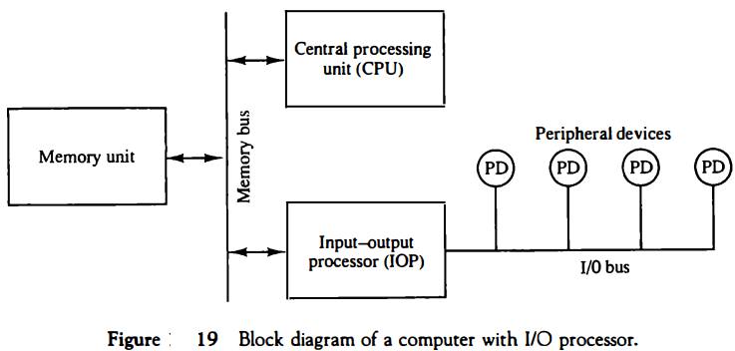
Input-Output Processor (IOP) Discussed

Slide 50
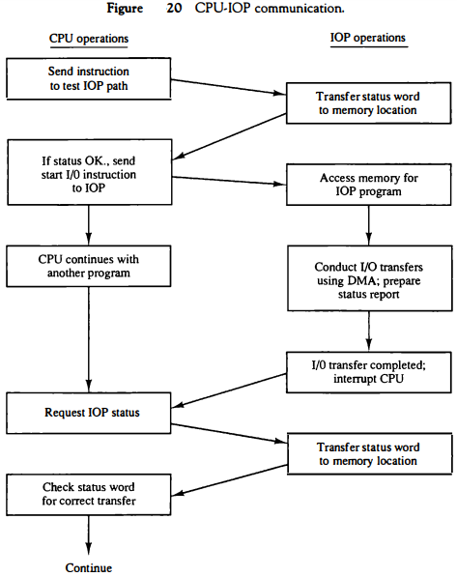
CPU-IOP Communication

Slide 51
Alternative DMA Configurations
With processor controlled programmed I/O, each transfer of a word consumes two bus cycles.
The number of required bus cycles can be cut by integrating the DMA and I/O functions.
In both of these cases (Figures7.13b and c), the system bus that the DMA module shares with the processor and memory is used by the DMA module only to exchange data with memory.
The exchange of data between the DMA and I/O modules takes place off the system bus.

Slide 52
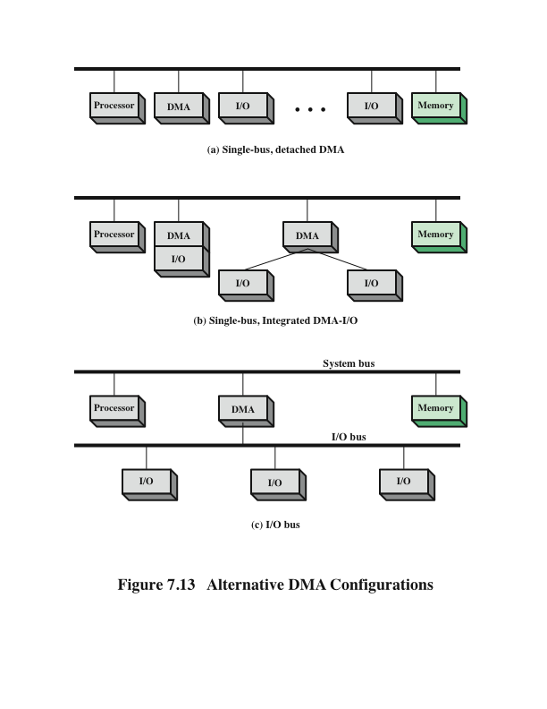
Alternative DMA Configurations
A Single DMA cannot handle all type of I/O device so we need multiple

Slide 53
I/O Channel
The I/O channel represents an extension of the DMA concept. An I/O channel has the ability to execute I/O instructions, which gives it complete control over I/O operations. In a computer system with such devices, the CPU does not execute I/O instructions.
Two types of I/O channels are common
Selector Channel
Multiplexor Channel

Slide 54
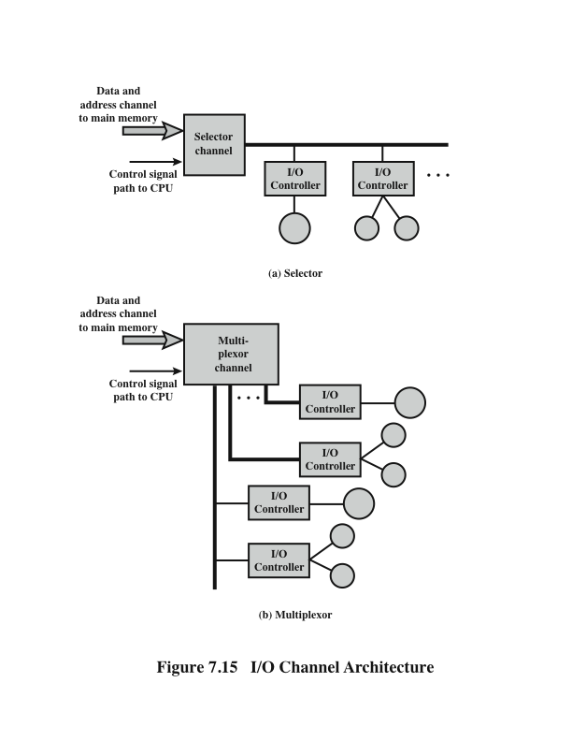
I/O Channel(Discussed)

Slide 55
InfiniBand
Recent I/O specification aimed at the high-end server market
First version was released in early 2001
Standard describes an architecture and specifications for data flow among processors and intelligent I/O devices
Has become a popular interface for storage area networking and other large storage configurations
Enables servers, remote storage, and other network devices to be attached in a central fabric of switches and links
The switch-based architecture can connect up to 64,000 servers, storage systems, and networking devices
Notes:
InfiniBand is a recent I/O specification aimed at the high-end server market. The
first version of the specification was released in early 2001 and has attracted numerous
vendors. The standard describes an architecture and specifications for data flow
among processors and intelligent I/O devices. InfiniBand has become a popular
interface for storage area networking and other large storage configurations. In
essence, InfiniBand enables servers, remote storage, and other network devices to
be attached in a central fabric of switches and links. The switch-based architecture
can connect up to 64,000 servers, storage systems, and networking devices.
Although PCI is a reliable interconnect method
and continues to provide increased speeds, up to 4 Gbps, it is a limited architecture
compared to InfiniBand. With InfiniBand, it is not necessary to have the basic I/O
interface hardware inside the server chassis. With InfiniBand, remote storage,
networking, and connections between servers are accomplished by attaching all
devices to a central fabric of switches and links. Removing I/O from the server
chassis allows greater server density and allows for a more flexible and scalable data
center, as independent nodes may be added as needed.
Unlike PCI, which measures distances from a CPU motherboard in centimeters,
InfiniBand’s channel design enables I/O devices to be placed up to 17 meters
away from the server using copper, up to 300 m using multimode optical fiber, and
up to 10 km with single-mode optical fiber. Transmission rates has high as 30 Gbps
can be achieved.

Slide 56
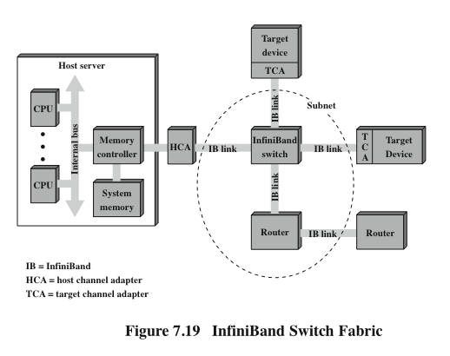
InfiniBand Switch Fabric
Notes:
Figure 7.19 illustrates the InfiniBand architecture. The key elements are as
follows:
• Host channel adapter (HCA): Instead of a number of PCI slots, a typical
server needs a single interface to an HCA that links the server to an InfiniBand
switch. The HCA attaches to the server at a memory controller, which has
access to the system bus and controls traffic between the processor and memory
and between the HCA and memory. The HCA uses direct-memory access
(DMA) to read and write memory.
• Target channel adapter (TCA): A TCA is used to connect storage systems,
routers, and other peripheral devices to an InfiniBand switch.
• InfiniBand switch: A switch provides point-to-point physical connections to a
variety of devices and switches traffic from one link to another. Servers and
devices communicate through their adapters, via the switch. The switch’s
intelligence manages the linkage without interrupting the servers’ operation.
• Links: The link between a switch and a channel adapter, or between two
switches.
• Subnet: A subnet consists of one or more interconnected switches plus the links
that connect other devices to those switches. Figure 7.19 shows a subnet with
a single switch, but more complex subnets are required when a large number
of devices are to be interconnected. Subnets allow administrators to confine
broadcast and multicast transmissions within the subnet.
• Router: Connects InfiniBand subnets, or connects an InfiniBand switch to
a network, such as a local area network, wide area network, or storage area
network.
The channel adapters are intelligent devices that handle all I/O functions without
the need to interrupt the server’s processor. For example, there is a control
protocol by which a switch discovers all TCAs and HCAs in the fabric and assigns
logical addresses to each. This is done without processor involvement.
The InfiniBand switch temporarily opens up channels between the processor
and devices with which it is communicating. The devices do not have to share a
channel’s capacity, as is the case with a bus-based design such as PCI, which requires
that devices arbitrate for access to the processor. Additional devices are added to
the configuration by hooking up each device’s TCA to the switch.

Slide 57
InfiniBand Operation
Each physical link between a switch and an attached interface can support up to 16 logical channels, called virtual lanes
One lane is reserved for fabric management and the other lanes for data transport
A virtual lane is temporarily dedicated to the transfer of data from one end node to another over the InfiniBand fabric
The InfiniBand switch maps traffic from an incoming lane to an outgoing lane to route the data between the desired end points
A layered protocol architecture is used, consisting of four layers:
Physical
Link
Network
Transport
Notes:
Each physical link between a switch and an attached
interface (HCA or TCA) can be support up to 16 logical channels, called virtual
lanes. One lane is reserved for fabric management and the other lanes for data
transport. Data are sent in the form of a stream of packets, with each packet
containing some portion of the total data to be transferred, plus addressing and
control information. Thus, a set of communications protocols are used to manage
the transfer of data. A virtual lane is temporarily dedicated to the transfer of data
from one end node to another over the InfiniBand fabric. The InfiniBand switch
maps traffic from an incoming lane to an outgoing lane to route the data between
the desired end points.
Figure 7.20 also indicates that a layered protocol architecture is used, consisting
of four layers:
• Physical: The physical-layer specification defines three link speeds (1X,
4X, and 12X) giving transmission rates of 2.5, 10, and 30 Gbps, respectively
(Table 7.3). The physical layer also defines the physical media, including copper
and optical fiber.
• Link: This layer defines the basic packet structure used to exchange data,
including an addressing scheme that assigns a unique link address to every
device in a subnet. This level includes the logic for setting up virtual lanes and
for switching data through switches from source to destination within a subnet.
The packet structure includes an error-detection code to provide reliability.
Network: The network layer routes packets between different InfiniBand
subnets.
• Transport: The transport layer provides reliability mechanism for end-to-end
transfer of packets across one or more subnets.

